Slide 1
BSIS Backup and Disaster Recovery Plan 2017 Presenter: Tendayi

Slide 2
Overview
BSIS overview
Backup and Disaster Recovery Plan
What is Data Recovery?
Typical causes of data loss
What is BSIS data loss
What might cause BSIS data loss
Facts about data recovery
Software backup and database solution
What can you do?
Periodic testing of database backups
Disaster recovery procedure

Slide 3
What is BSIS?
The Blood Safety Information System (BSIS) is an open source information system designed to manage donor and blood safety information from the point of donor registration to donation collection, through to laboratory testing, component processing and labelling, storage and distribution to hospitals and clinics.

Slide 4
Backup and Disaster Recovery Plan
As part of the business continuity plan designed to minimize disruption to the service in case of system failure or unavailability, the backup and disaster recovery plan is used to outline the steps taken in the case of system failure, and how to recover the system to bring it back into operation
The following International standard were used to come up with BSIS backup and data recovery strategy.
AFSBT
ISBT
AABB

Slide 5
Backup and Disaster Recovery Plan
AFSBT
Routine backup of all critical data. Backup data shall be stored in an off-site location.
Procedures shall be in place to ensure that data are retrievable and usable.
ISBT
Disaster recovery plan should be prepared detailing how the system will be recovered and brought back into operation
AABB
Review information technology systems and develop redundancies to ensure that vital systems and their supporting subsystems remain operational during an emergency.

Slide 6
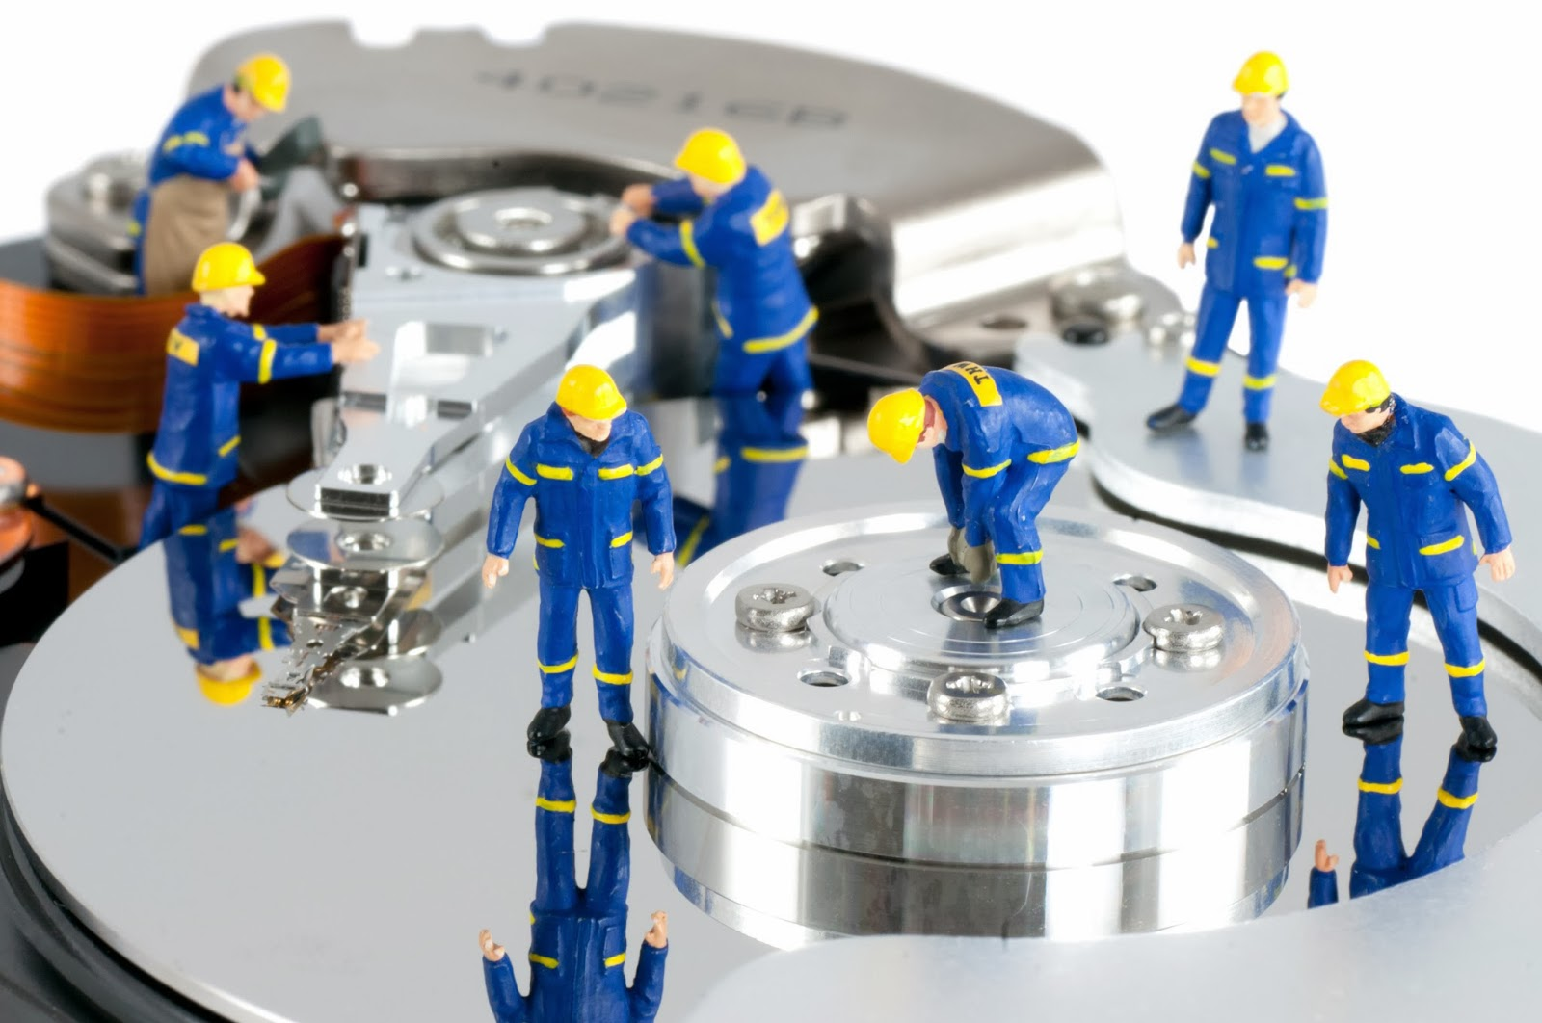
What is BSIS Data Recovery?
It is the process of retrieving deleted/inaccessible BSIS data from electronic storage media (live server’s hard drives)

Slide 7
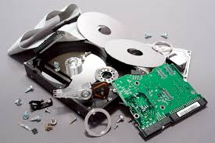
Typical causes of loss include
Electro-mechanical failure
Natural Disaster
Computer Virus
Data Corruption
Computer Crime
Human Error

Slide 8
What is BSIS Data Loss?
BSIS data is accidentally erased or data control structures have been overwritten.
Data has been corrupted or made inaccessible.
BSIS data is unable to be accessed from a previous functioning computer system or backup.

Slide 9
What might cause BSIS Data loss?
Sabotage
Hackers
Unauthorised internal personnel
Natural Disaster
Fire
Floods
Hardware Error
Disk drive crashes, electrical outages or power
Manufacturer defects
Virus Attack
Malware and virus infections

Slide 10
What might cause BSIS Data loss?
Human Error
Intentional deletion
Accidental deletion or overwriting of files
Software Corruption
Application displaying error messages

Slide 11
Facts about Data Recovery
The majority of data loss situations are recoverable
Computer storage systems may fail, but the data stored on them is not always completely lost
There are occasions when the damage is permanent and complete data recovery is not possible. However some data is usually always recoverable.
Data recovery professionals can recover data from crashed hard drives, operating systems using various data recovery tools and techniques

Slide 12
Software and database backup solution
Jembi will provide a basic solution of backing up and restoring the database.
The full system backup and restore will be provided, where an image of the live server will be done by the implementer and shared with the blood service.
As for the database, an automatic job is created on the live server, it is the blood service’s responsibility to download it every day to a backup media, e.g. external HD.
The backup should also be stored offsite, and the intervals will be determined by the blood service.

Slide 13
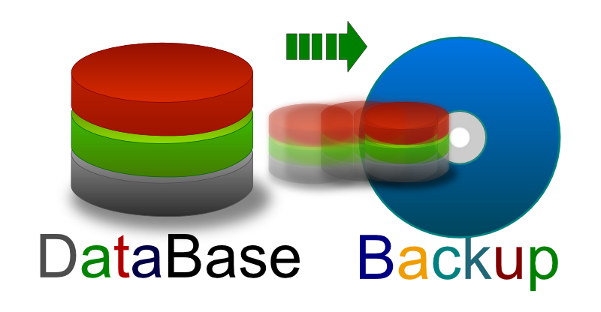
What can you do
Periodic database backups
The production database will be backed up daily and stored on a computer or hard drive located offsite from the production server in a secure environment, to ensure the safety of the backups in the case of disaster at the site where the production server is hosted.
Backups will be tested periodically, to validate the recovery process using these database backups
To test recovery from the database backups, the staging server may be used, if the application versions on the production and staging instances match. If this is not the case, an alternate plans is needed to provide an instance of the system to test recovery.

Slide 14
What can you do
To test recovery, the most recent database backup should be used.
The database running on the recovery test system should be backed up and removed, and the database backup will then be loaded onto the system to validate that the system operates as expected using this backup.
Following validation of the recovery test procedure, the database backup should be removed, and restored back to the initial database running on the recovery test system.
In the case where validation of the recovery test procedure and database backup fails, the database backup procedure should be reviewed to ensure it is running properly and without issues.

Slide 15
What can you do
Disaster recovery procedures
In the case of system or server failure, or other disasters that prevents the use of the production server, steps will be taken to set up a new replacement production server
A temporary system will be set up on an alternate or staging server, to ensure system continuity.
To set up a temporary system assumes that the server has already been setup with the BSIS application running, using the same application versions as the production server. The most recent database backup should be used when restoring the system.
If a temporary system is unavailable, a continuity action plan will be implemented to ensure critical data is still captured using other means

Slide 16
What can you do
In the case where a temporary server was put in place, the database will be backed up from there and used to restore the new production server database. Otherwise, the most recent database backup should be used when restoring the system.
Back entry will be required, depending on the time the systems were down.

