Slide 1
Rwanda HIE | RHEA
Carl Fourie
Assistant Director of Programs
Jembi Health Systems

Slide 2
Overview
Introduction
  Project Introduction
  Team
  Funders
Project
  Project Design and Overview
  Project History
Where we are today
Demonstration
Architecture
Component Overviews
Q&A

Slide 3
Glossary
Term | Definition
RHEA | Rwanda Health Enterprise Architecture Project
HIE | Health Information Exchange
SHR | Shared Health Record
CR | Client Registry
PR | Provider Registry
FR | Facility Registry
TS | Terminology Service
HIM | Health Information Mediator
PoC | Point of Care

Slide 4
Rwanda Health Enterprise Architecture (RHEA) Project
RHEA is an initiative of the Rwandan Ministry of Health eHealth Coordination Unit.
RHEA seeks to develop and implement an health enterprise architecture for Rwanda.

Slide 5


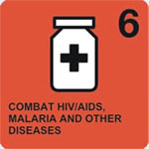
RHEA Objectives
To develop a pilot implementation HIE in Rwanda focused on the maternal health care system in Rwanda.
Expand the understanding of HIE in Rwanda within the health delivery system and the technical community.
Complete an Implementation Science/Research Project to present the impact of a health information exchange (HIE) on the maternal healthcare delivery system in Rwanda

Slide 6
Rwanda HIE
A project within a project
  Rwanda HIE within RHEA
Implementation and instantiation of a HIE based on the data from RHEA
  Requirements
  Workflows
  Objectives
  Standards
  all utilized within the development process

Slide 7
Project Admin
The RHEA project has been active for over 3 years
A large set of team members have actively collaborated and contributed towards it.
An example of donor harmonization and working towards a common goal.

Slide 8
Funders
Initial funding
  International Development Research Center (IDRC) and Rockefeller Foundation (RF) 2009-2012
Additional funding
  Health Informatics Public Private Partnership (HI-PPP), a project funded by the US President’s Emergency Plan for AIDS Relief (PEPFAR);

Slide 9
Team Overview
Ministry of Health, Rwanda
Jembi Health Systems, South Africa & Rwanda
Regenstrief Institute, USA
InSTEDD, USA
Pivot Access, Rwanda
IntraHealth
SysNet International
Apelon
HEAL, University of KwaZulu-Natal, South Africa
Liz Peloso
Mead Walker
Partners in Health
Millennium Villages Project
World Health Organization
Nethope
Mohawk College
ecGroup
Open Health Tools
HingX
BLeao Informatica em Saúd, Brazil
eZ-Vida, Brazil
CDC, USA

Slide 10
Project Design
RHEA is broken down into 5 sub-projects:
  Implementation Science/Research Project
    To develop an implementation science and evaluation framework to assess the potential impact of providing access to foundational registries and services and improving interoperability between applications.
  Technical Assessment Project
    To perform an assessment of the proposed technology solution and evaluate the potential to fulfill the requirements for an HIE in Rwanda
  Requirements and Scoping Project
    To define and configure foundational components of the HIE in Rwanda, including client and provider registries, terminologies and shared health record and to accurately scope, define and plan for the implementation pilot.
  Implementation First Phase Project
    To create the evaluation environment to support the research project.
  Capacity Building/Country Office Project
    To develop capacity in Rwanda and to open a country office to coordinate the work, going forward.

Slide 11
Implementation First Phase Project
Development of the Rwanda HIE
  Various sub-projects around software development and innovation
  SHR, CR, PR, FR, TS, OpenHIM, PoC
Implementation at Health Centres and in district
  Training and capacity development
    Health centres and MoH support staff
  Workflow overview and analysis
  Hand in Hand collaboration for planned ongoing MoH support of implementation.
  Rwamagana District
    12 Health Centres & District Hospital

Slide 12
Project Update
Implementation Science/Research Project
  Refocused and under new planning
Technical Assessment Project
  Complete
Requirements and Scoping Project
  Complete
Implementation Pilot Project
  Initial version, implementation underway, ongoing support.
Capacity Building/Country Office Project
  Underway and ongoing.

Slide 13
A time to reflect and remember
RHEA has contributed to and had contributions from other projects
Multiple collaborations
Multiple revisions and designs
RHEA represents a collaborative, iterative and adaptive design philosophy in health systems development and implementation

Slide 14
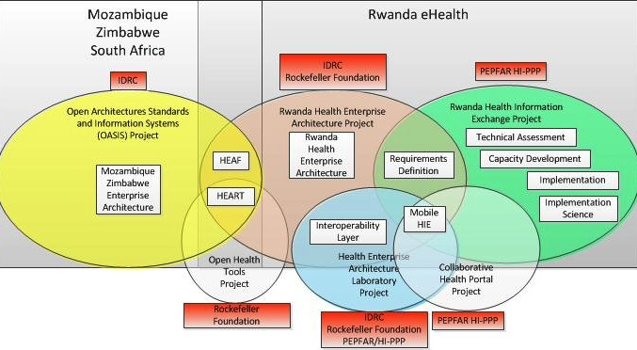
OASIS – RHEA – HIE Projects

Slide 15
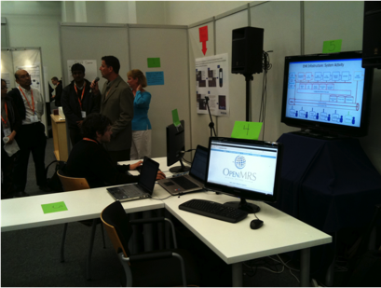
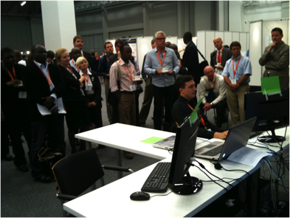

Timeline
September 2010:
  Medinfo Demo
  First Demonstration of Architecture
TIME
LINE
2010
2011
2012
2013

Slide 16
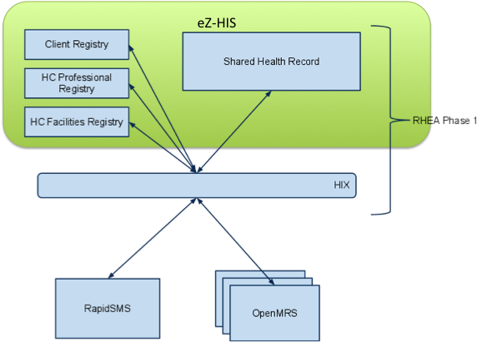
Timeline
March 2011
eZ-Vida stack Demonstration
Kigali
TIME
LINE
2010
2011
2012
2013

Slide 17

Timeline
June|July 2011
eZ-Vida Training, Brazil
Technology insight / exploration
TIME
LINE
2010
2011
2012
2013

Slide 18
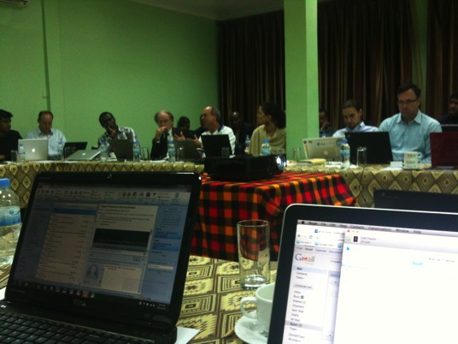
Timeline
October 2011
Low Hanging Fruit Project (LHF v1.0)
  Facility Registry
Kigali, Rwanda
TIME
LINE
2010
2011
2012
2013

Slide 19
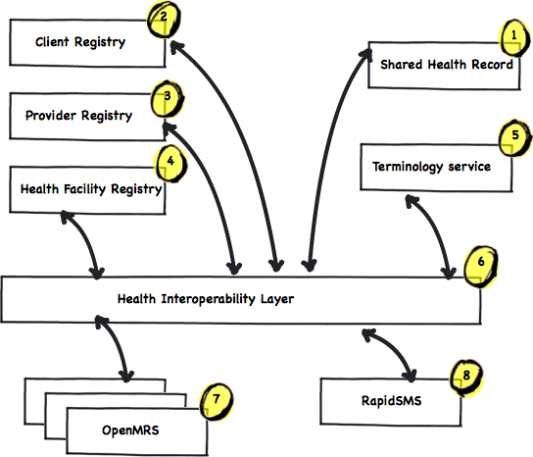
Timeline
March 2012
LHF v1.5
Move to new architecture
TIME
LINE
2010
2011
2012
2013

Slide 20
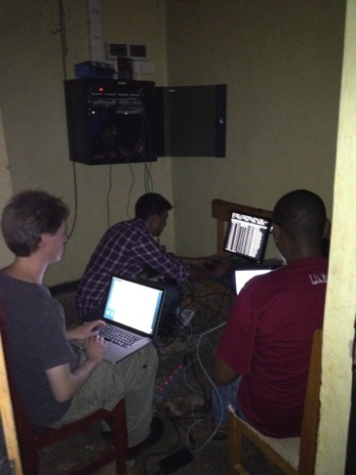
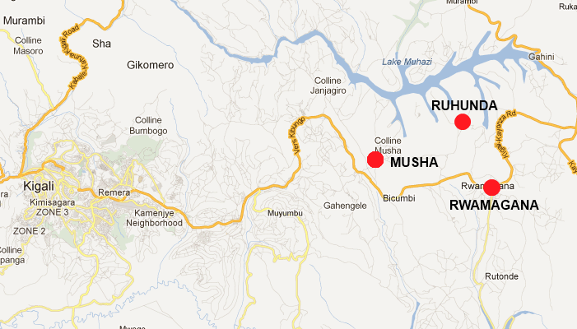


Timeline - Today
September 2012:
  Rwanda HIE live in NDC
  2 Sites Deployed
TIME
LINE
2010
2011
2012
2013

Slide 21
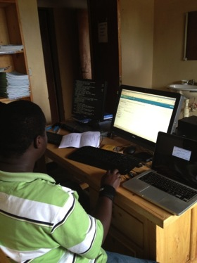
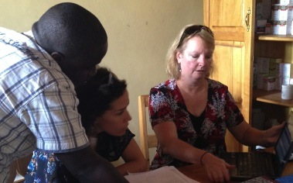
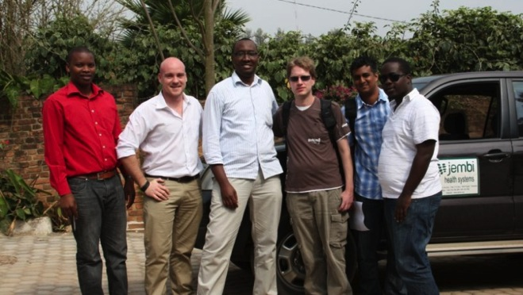
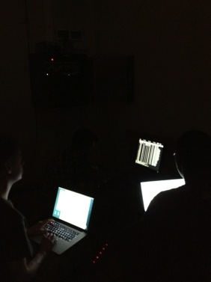
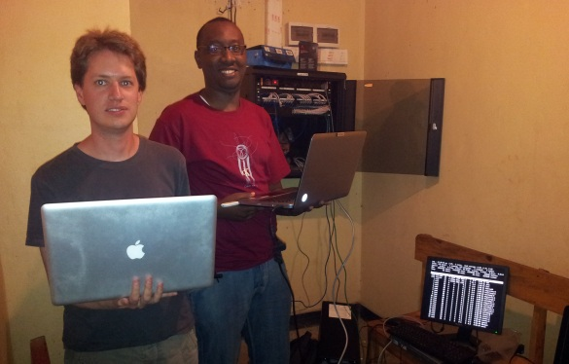
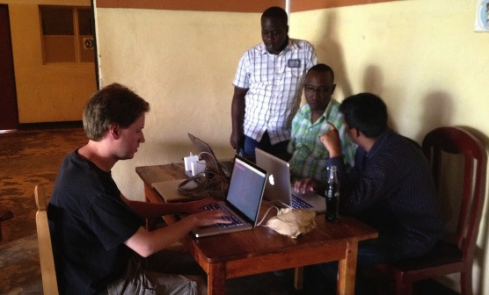

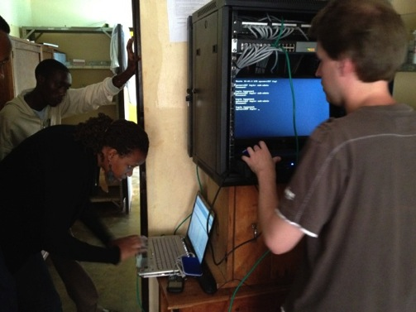
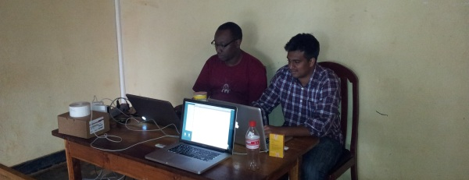

Slide 22
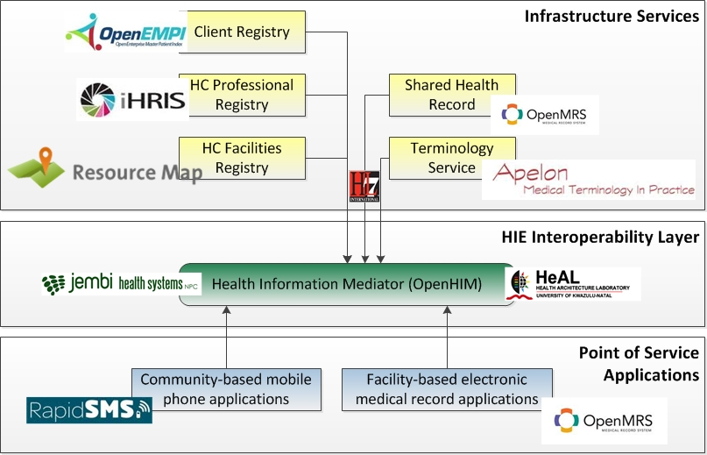
Demonstration

Slide 23
Architecture

Slide 24
Design
Client registry – a database which uniquely identifies and holds all consumers (clients/patients) of health care services nationally. This is potentially every person in the country.
Provider registry- a database which uniquely identifies and holds all providers of health care services nationally.
Facility registry- a database which uniquely identifies and holds all facilities providing health care services nationally. This will include the specific service “packages” they provide.
Shared health record- a shared repository which forms a longitudinal patient record.
Interoperability Layer (iHIX)- Connections to point of care applications and registries
Point of Care Applications- All applications being implemented in the pilot leveraging off the shared architecture.

Slide 25
SHR: Shared Health Record
Business function:
  Maintain a person centric longitudinal health record.
Technology built on:
  OpenMRS – custom module
  HL7 message standards
Technical Team
  Jembi Health Systems, OpenMRS community

Slide 26
What does it do? | Services
Storage and retrieval of patient data
Maintains a longitudinal health record
Business Alerting : Triggers SMS alerts
Auditability
Interfaces:
  HL7 data set
  Web service interface
  PLUG
    Post | Get

Slide 27
What does it look like

Slide 28
Possible Next Steps | Future feature
Performance testing and tuning for 9 million people
Link to Indicator Reporting systems
Advanced Business alerting

Slide 29
TS: Terminology Service
Business function:
  Promote semantic interoperability between systems/components by providing terminologies for common reference
Technology built on:
  Apelon DTS
  HTML/PHP/Javascript/Java/Twitter bootstrap
Technical Team
  Jembi Health Systems

Slide 30
What does it do? | Services
Storage of terminology sets
ICD10, LOINC, Rwanda Extension to LOINC, and lots more
Interfaces:
  DTS Editor
  Website
  Web service interface

Slide 31
Q&A

Slide 32
2010
2011
2012
2013

Slide 33

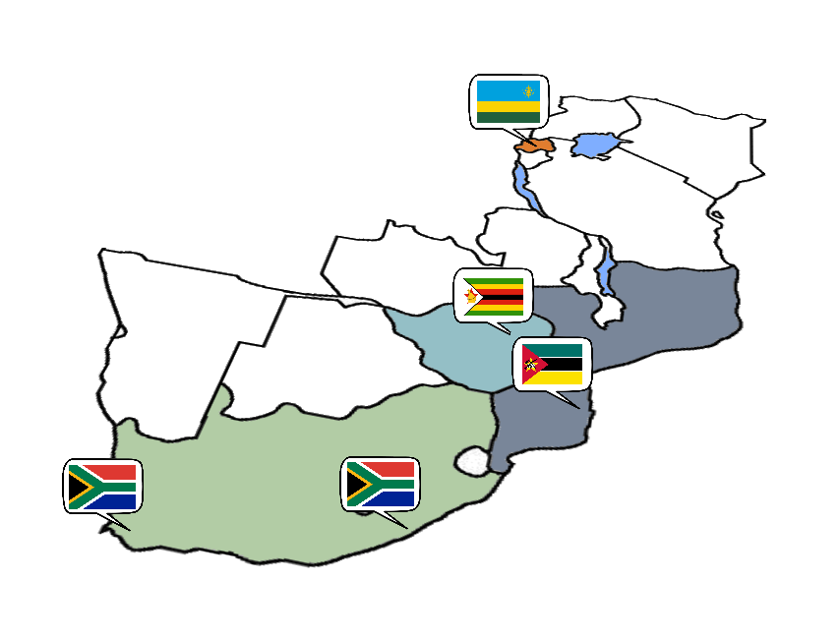
Thank you
Mozambique
Avenida Julius Nyerere no 3326
Condominio Diplomatic Village
Casa numero um
Maputo
Rwanda
Kacyiru Road
Plot Number 1760
Kigali
South Africa

