Slide 1
RHEA
Facility Registry
Kigali, Sept 23

Slide 2
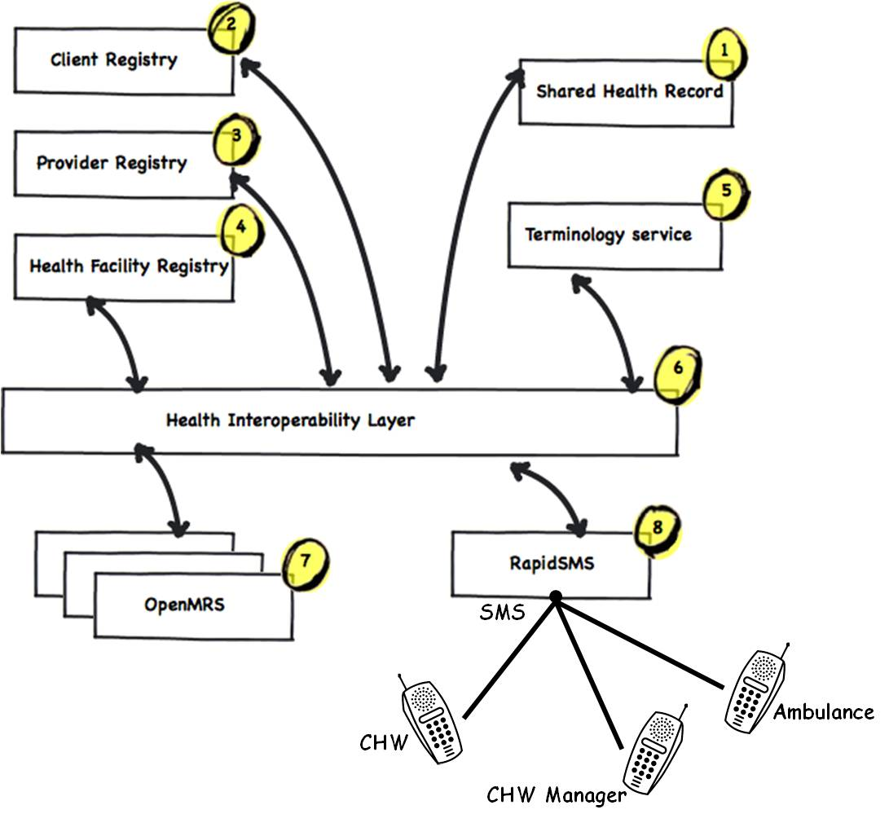

Slide 3
FR: Facility Registry
Business function:
Registry of facilities, services provided, and other metadata
Based on:
Team: RHEA Team & InSTEDD developers (iLab + Platform)
Tech | Design | Integration
Ruby on Rails, MySQL, ElasticSearch Google Maps & OSM | Started in Cambodia 2 ys. ago, local devs Used by NGOs in national projects | REST API Trigger/Event Streams Added GeoJSON APIs for FRED

Slide 4
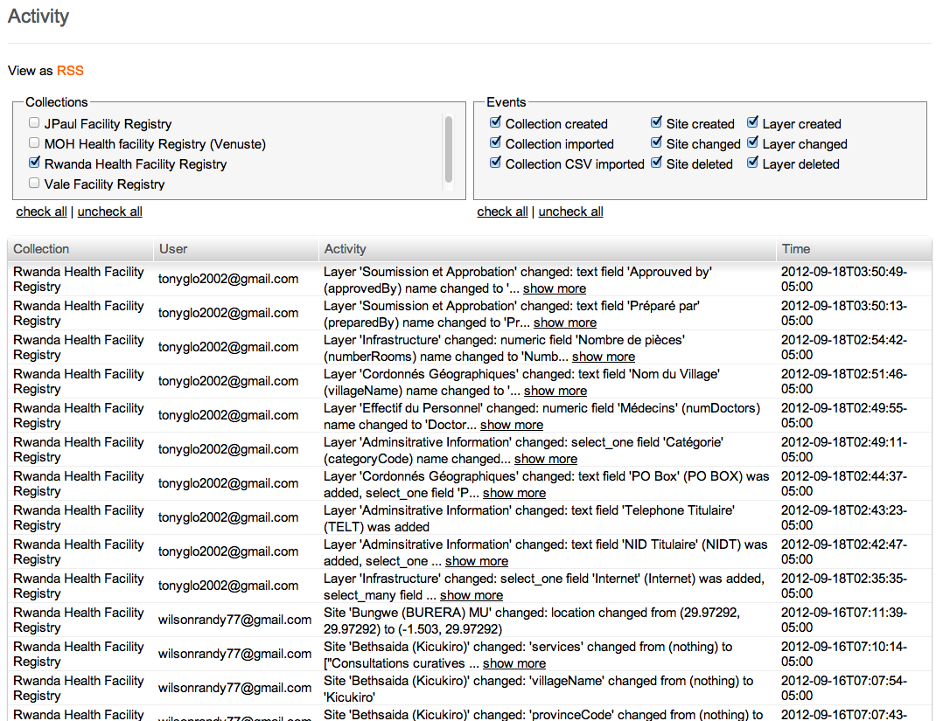
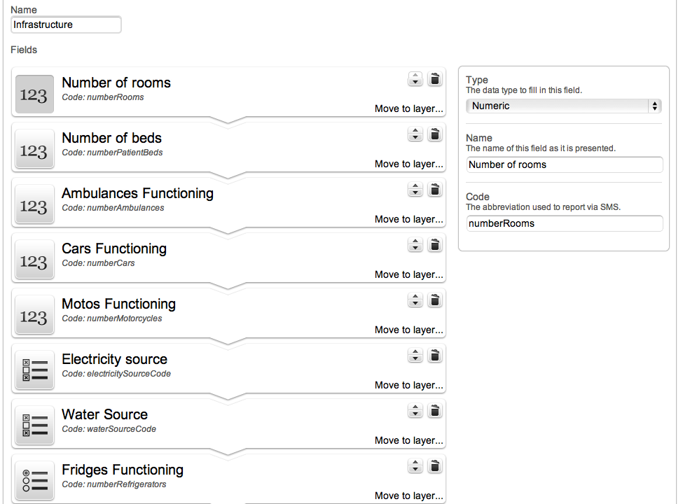
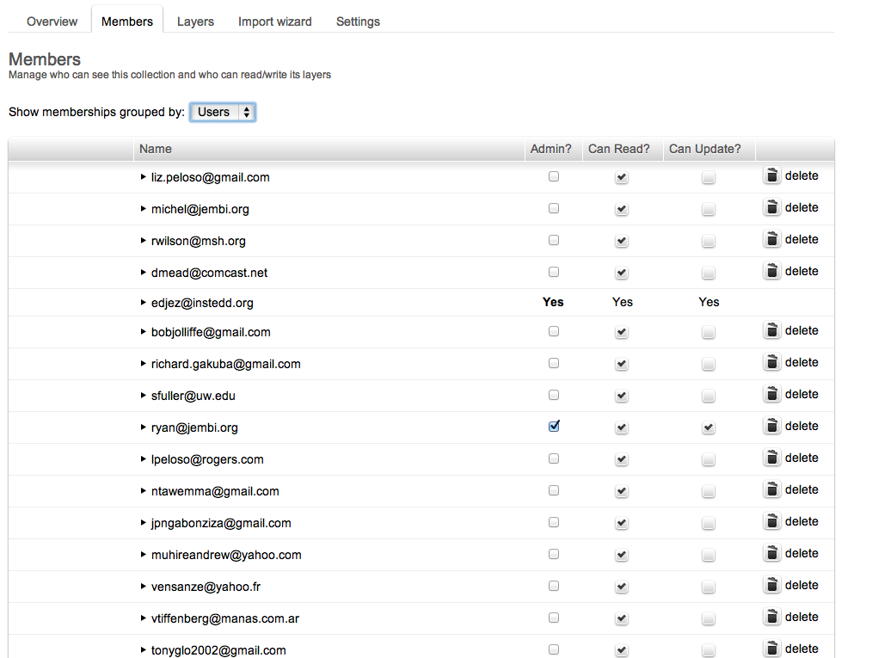
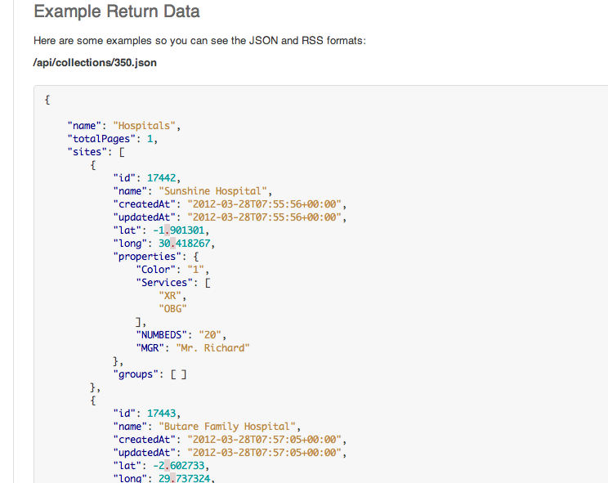
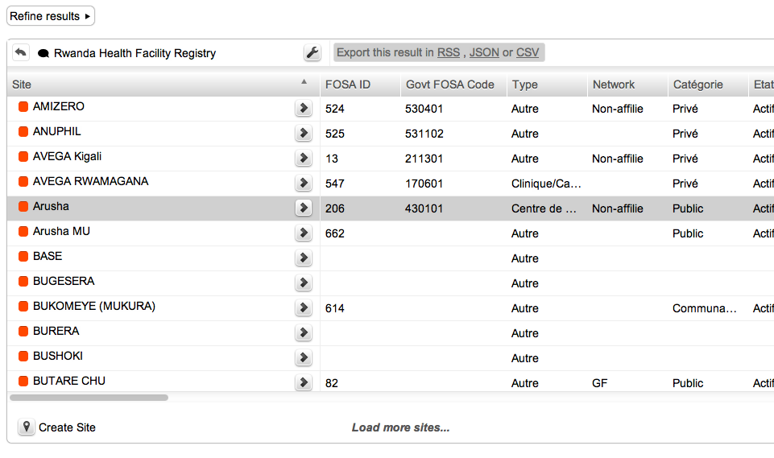
Key Functionality
Browse, query, filter, manage data
Visualize in maps & lists
Define facility information schema
Manage visibility & read/write permissions
Expose API for data changes and event triggers
Keep historical version sets (see past data)
Expose XML, JSON and GeoJSON APIs
Plug ins for
Advanced Permissions
Thresholds, Alerts
Mobile queries, updates, staff reminders

Slide 6
Next Steps
RHEA (Suggestions)
DHIS2 Integration
Evaluate further use cases and needs of MOH
Further capacity building in hosting ops & dev on API
FRED (tbd)
Re-incorporate resource management aspects?
Continue to incorporate API ideas
Discuss applied use with other countries (eg Tz)
General:
Continue to evolve from other applied use worldwide
Continue to work on plug in designs

