Slide 1
Client Registry
OpenEMPI: Data Support Training
SYSNET International, Inc.

Slide 2
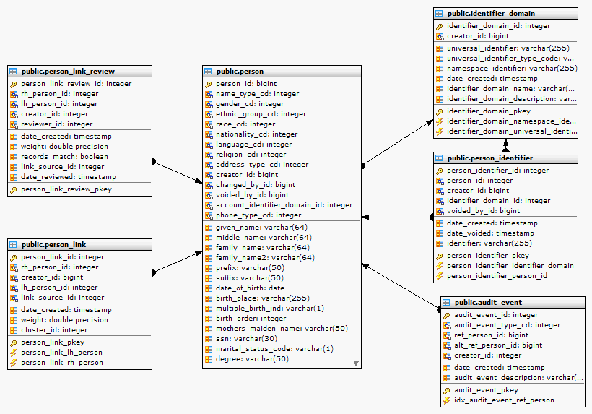
Client Registry
Overview of OpenEMPI data model

Slide 3
Overview of Data Support Tasks
Searching the Client Registry using an Identifier
Searching the Client Registry using demographic attributes
Generating Reports
Reviewing event summary statistics
Reviewing duplicate data statistics
Reviewing potential matches report
Resolving potential matches

Slide 4
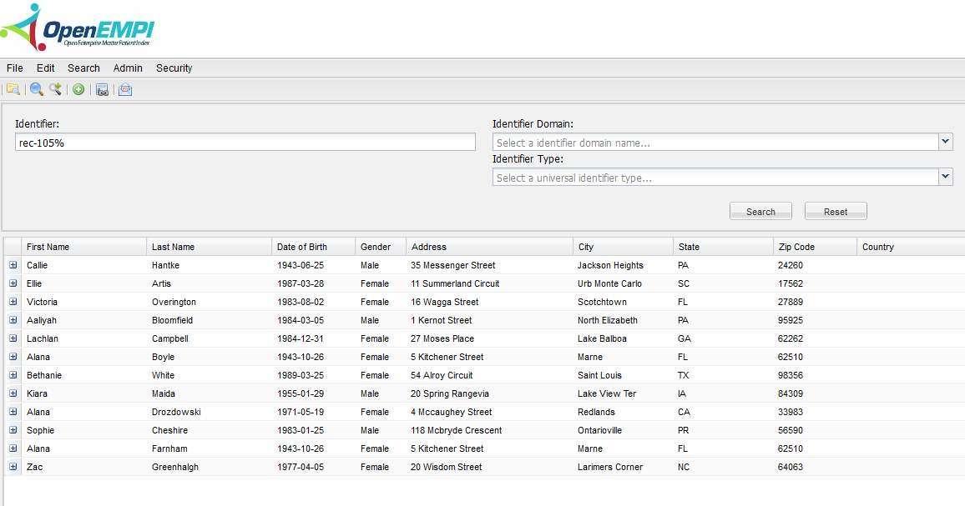
Search by Identifier
Search using a portion of the identifier
Can also specify identifier domain

Slide 5
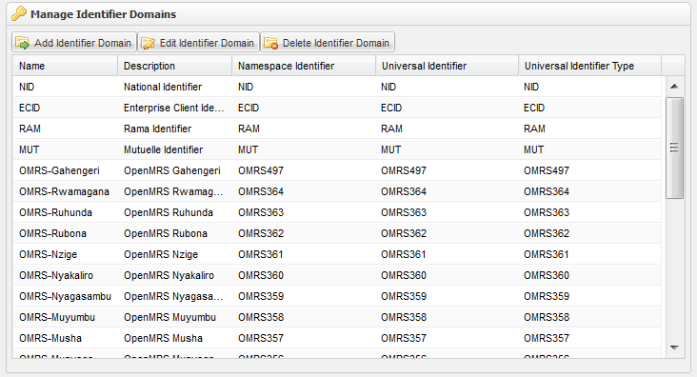
Identifier Domains
Each organization that can issue an identifier is considered a separate identifier domain

Slide 6
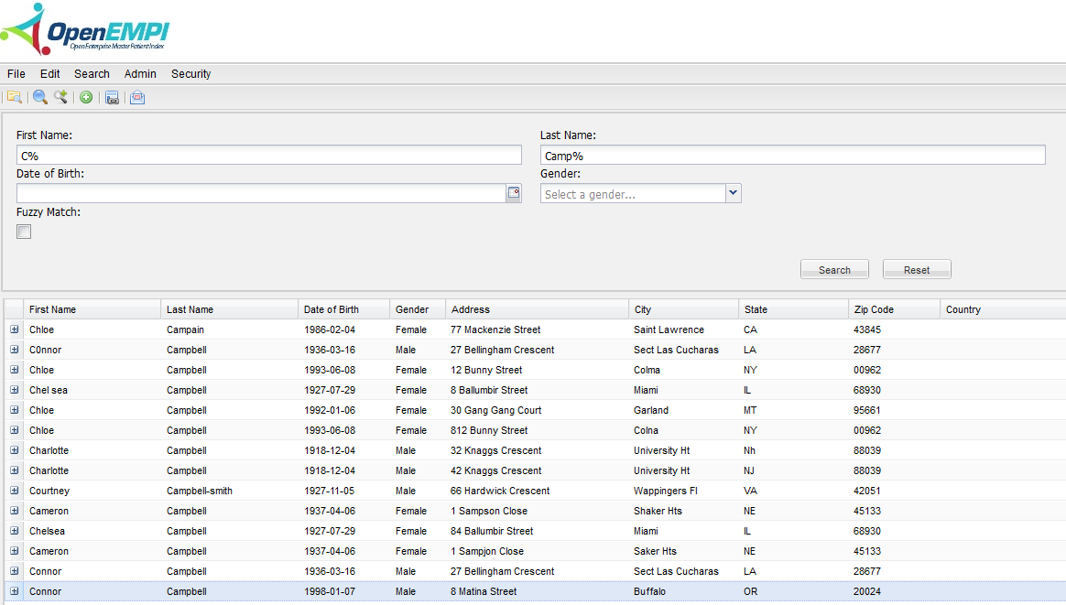
Search by Patient Attributes
Need to provide sufficient criteria to restrict the number of matching entries

Slide 7
Viewing linked patient records
Example of two similar record that have been linked together

Slide 8
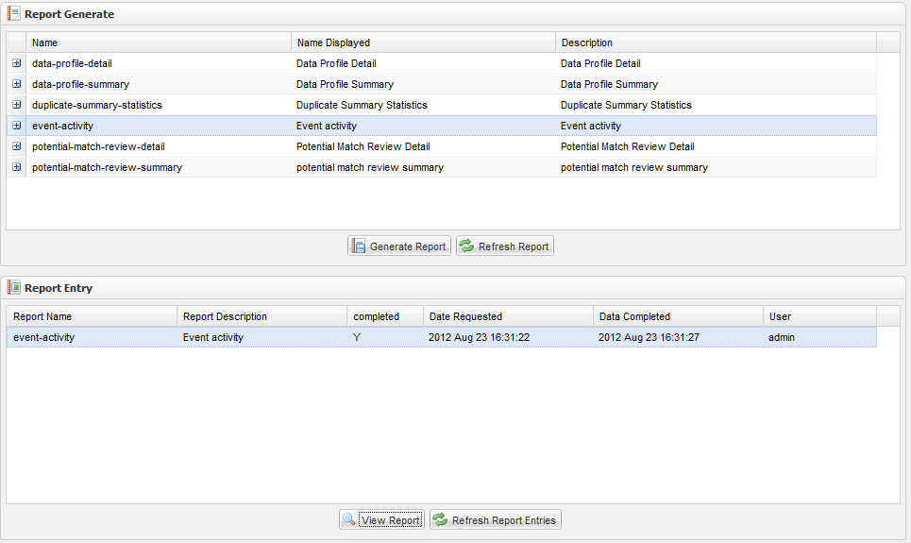
Generate Reports
Select one of the report types and generate it

Slide 9
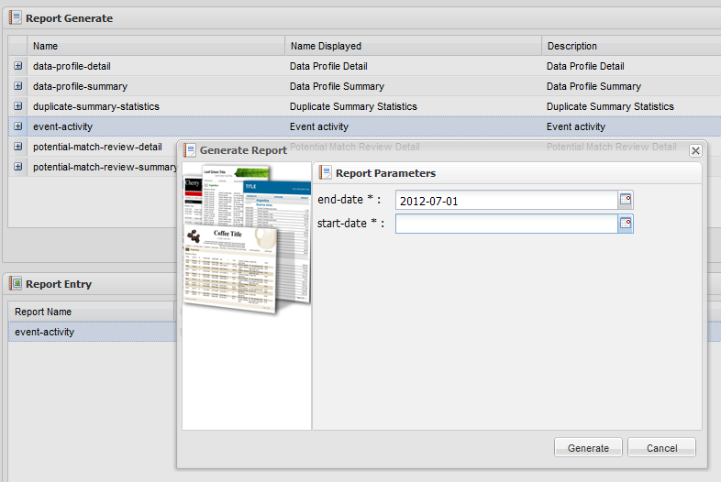
Example: Event Activity
Some reports require input parameters (usually a date range of interest).

Slide 10
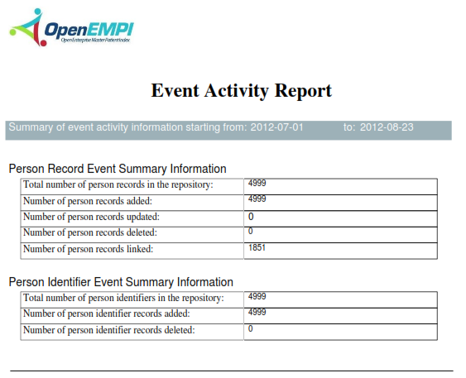
Example: Event Activity
Some reports may take time to finish; refreshing the table will let you know when report generation is done

